Slide 1

WHEREVER, WHENEVER.
flexit@flexit.fit
www.flexit.fit
Spring 2018
Confidential & Proprietary
Notes:
FONTING: we’re using nexa bold here, but glacial indifference elsewhere. Thoughts?
1AA6C9
A5A5A6

Slide 2

OPPORTUNITY | SOLUTION | BUSINESS
The fitness industry is ripe with opportunity, as the evolving needs of consumers challenge traditional models
$21.8B
Rev/year of the gym and health club industry
57.25M
Members of health clubs in the United States
67%
Of people with gym memberships never use them
$39
Per membership every month is wasted due to underutilization
Source: Statista, The Statistics Portal - 2016
Notes:
Other potential taglines:
The Fitness space is under attack by the needs of the dynamic customer
Trends in the fitness space are disrupting the status quo
The fitness space is facing disruption driven by the
Traditional gym models are under attack by the evolving needs of the customer

Slide 3
OPPORTUNITY | SOLUTION | BUSINESS
Consumers value experiences that offer flexibility, and fitness is no exception
Consumers are…
Empowered to maintain healthy lifestyles without overpaying
Conditioned by boutique fitness to a-la-carte access
Discouraged by memberships that require long-term commitments and are cumbersome to exit
Enjoy utilizing a variety of options
Digitally connected and value maximal convenience
Motivated by personalization and community
Notes:
Cost savings, pay for what you use and do waste money
Lets emphasize the consumer pain point, its not as clear as it should be
Punch up importance of value and transparency

Slide 4
OPPORTUNITY | SOLUTION | BUSINESS
Gyms face significant challenges in meeting their customers’ needs while navigating an increasingly competitive landscape
Gyms face…
High costs to launch and operate facilities
Difficulty attracting and retaining profitable customers
Adversity to long term-commitment
Proliferation of facilities, especially boutique studios, that have stolen market-share
Transient customers who spend substantial time in multiple locations
Demanding customers who desire personalization that is too costly to provide at scale
Tech-savvy customers who are conditioned to expect a sophisticated digital experience
Notes:
Cost savings, pay for what you use and do waste money
Lets emphasize the consumer pain point, its not as clear as it should be
Punch up importance of value and transparency

Slide 5
OPPORTUNITY | SOLUTION | BUSINESS
The industry is taking notice
… People, especially millennials, are searching for personalized experiences everywhere they go, and that includes looking for unique fitness and workout experiences with a small group of people they connect with on a personal level. Even if they’re traveling or away from home, they expect to be able to keep that routine by walking into a local boutique gym on a per-session basis or by using a digital fitness app outside, in a hotel – or almost anywhere for that matter ”
Adam Zeitsiff, CIO - Gold’s Gym International
January 2018
Notes:
As of 2017, anywhere from 5 percent to 26 percent of fitness operators, based on their business model, indicated they engaged with digital aggregators.
“Imagine a set of tablets when you arrive, and other self-service options to streamline a large group of individuals arriving at once, with helpful service professionals available as needed,” says Sarah Abdallah, an interior architect and designer, whose been tasked with incorporating wellness elements for clients like the Ritz-Carlton and Neuehouse, a private club and co-working space. Translation: a less frantic clamoring of leggings-clad folks scrambling to make it in time for the warm-up. “Technology can be integral in helping people make the transition from the chaotic outside world to going within,” -- “Well and Good”

Slide 6
OPPORTUNITY | SOLUTION | BUSINESS
FLEXIT…
is the solution that offers consumers the flexibility they expect while enhancing facilities’ profitability
Notes:
Other potential taglines:
The Fitness space is under attack by the needs of the dynamic customer
Trends in the fitness space are disrupting the status quo
The fitness space is facing disruption driven by the
Traditional gym models are under attack by the evolving needs of the customer
Align text

Slide 7
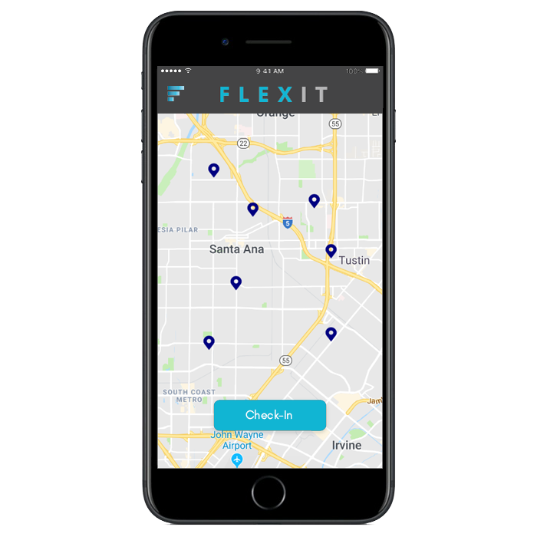
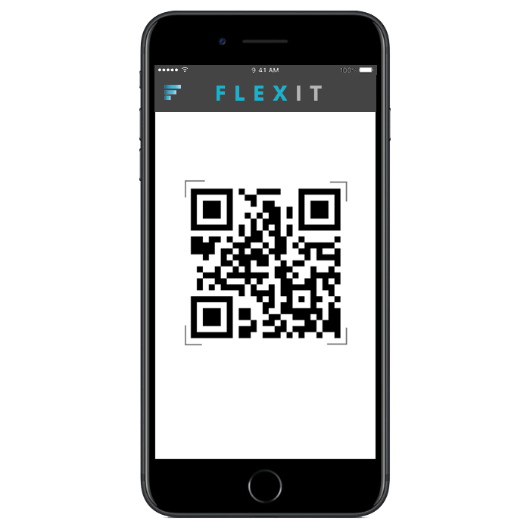
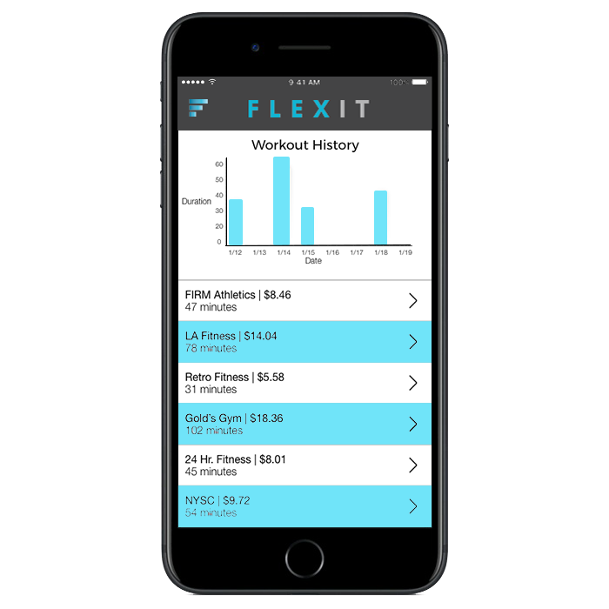
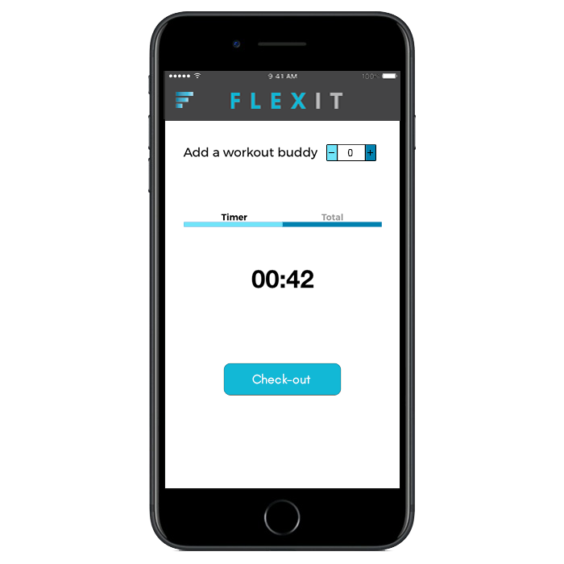
The FlexIt Customer Solution
An a-la-carte, non-membership solution to access health & fitness clubs wherever, whenever
Discover
Check-in
OPPORTUNITY | SOLUTION | BUSINESS
gyms in your community
with a quick and easy scan
THE MOBILE SOLUTION THAT PROVIDES A-LA-CARTE FITNESS ACCESS BY ENABLING USERS TO PAY FOR THE TIME THEY USE
Review
FLEXIT
your activity and progress
using the mobile app
Notes:
Not actual screens, just visual representations.

Slide 8


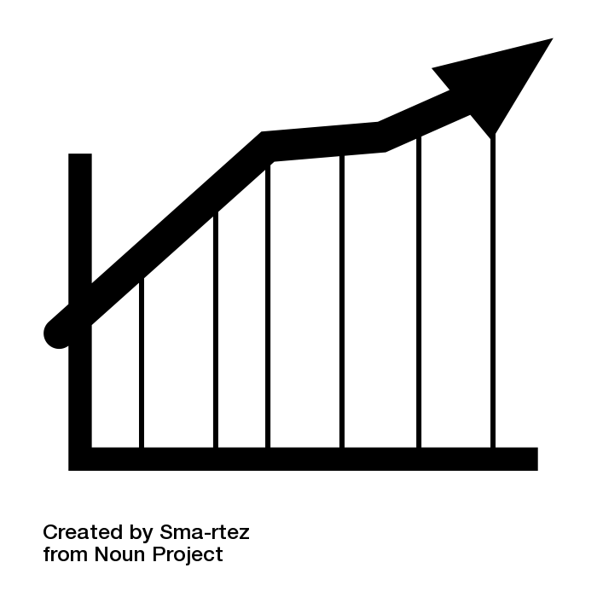






OPPORTUNITY | SOLUTION | BUSINESS
FLEXIT is a win win for consumers and gyms
Consumers
Gyms
Pay only for what
you use
Increased revenue
(via per-minute revenue share)
Access to a nation-wide
network of facilities
Prospective new
members
No long-term
commitments
Increased
membership-bases
Try before you buy
Increased foot traffic
Mobile-based solution that
enables a frictionless experience
Organic cross-promotion and marketing
Notes:
Cost savings, pay for what you use and do waste money
Lets emphasize the consumer pain point, its not as clear as it should be
Punch up importance of value and transparency

Slide 9
OPPORTUNITY | SOLUTION | BUSINESS
FLEXIT provides technology to scale for a growing market
200M
40M
5M
Total available market (TAM):
US Population 18-65
Serviceable addressable market (SAM): Adults who work out 2x/week
Serviceable obtainable market (SOM):
Realistic reach
Source: Statista, The Statistics Portal - 2016
Notes:
326 in US
47.8 over 65
Under 18 74M
NEED 326 NUMBER TO NOT INCLUDE ADULTS OVER 65, NOT INCLUDE KIDS UNDER 18
DO CONCENTRIC CIRCLES, NOT THE OVAL
57.3
Need % that go to the gym less than 8x per month
Maybe concentric circles
Market comp, center align
Wrapo more evely

Slide 10
OPPORTUNITY | SOLUTION | BUSINESS
FLEXIT provides technology to scale for a growing market
37K
12K
9K
Total available market (TAM):
Gyms in the US
Serviceable addressable market (SAM):
Gyms in the US that fit our model
Serviceable obtainable market (SOM):
Gyms in the US that we can obtain
Source: Statista, The Statistics Portal - 2016
Notes:
326 in US
47.8 over 65
Under 18 74M
NEED 326 NUMBER TO NOT INCLUDE ADULTS OVER 65, NOT INCLUDE KIDS UNDER 18
DO CONCENTRIC CIRCLES, NOT THE OVAL
57.3
Need % that go to the gym less than 8x per month
Maybe concentric circles
Market comp, center align
Wrapo more evely

Slide 11
OPPORTUNITY | SOLUTION | BUSINESS
FLEXIT will benefit from multiple revenue streams that will enable sustainable value delivery
Gym Usage
Available at initial product launch
Monthly Maintenance
FLEXIT will share usage revenue with gyms based on agreed upon split
Price per minute will be defined on the gym level and reflect specific market factors
Gyms will be subject to a monthly maintenance fee to offset FLEXIT cost
Gym Activation
Membership Conversion
Gyms will be subject to a one-time fee to join the FLEXIT network
The fee will vary based on the number of gym branches that are on-boarded
FLEXIT will charge the gym owner a fee for every membership commitment they convert
Premium Analytics
Mobile Advertising
Gym owners may access premium customer analytics data for a monthly fee
Mobile app SEO capabilities can prioritize gym in users search windows
Available post initial launch
Notes:
Revenue Split of Gym Time Usage
Gym Activation Charge
Gym Maintenance Charge
Gym Premium Analytics Service

Slide 12
OPPORTUNITY | SOLUTION | BUSINESS
FLEXIT has a multifaceted approach to acquiring and retaining customers
Digital
PR
Cost: $$$
Effectiveness: High
Cost: $$$
Effectiveness: High
Social Media
Search Engine
Influencer
Cost: $
Effectiveness: Medium
Cost: $$
Effectiveness: Medium
Cost: $$
Effectiveness: Medium
Partnerships
Email
Affiliate
Offline
Cost: $$
Effectiveness: Low
Cost: $
Effectiveness: Medium
Cost: $
Effectiveness: Medium
Cost: $
Effectiveness: Low
Notes:
Lets add affiliate programs in here, will be very important! Add to middle tier (rewards etc)
Thinking about eliminating the cost/effectiveness thing?
Can we put email on the middle line on the left side and put content and blogging as two separate items on the bottom line?

Slide 13













FLEXIT is more affordable and experiential than its competition
An a-la-carte, non-membership solution to access health & fitness clubs wherever, whenever
OPPORTUNITY | SOLUTION | BUSINESS
FLEXIT is more affordable and flexible than its competition
Flexible
Expensive
Affordable
Inflexible
Notes:
Not actual screens, just visual representations.
Expand it out
ADD SOMETHING BOTTOM LEFT AND BOTTOM RIGHT – RETRO BOTTOM RIGHT? WHAT BOTTOM LEFT?

Slide 14
OPPORTUNITY | SOLUTION | BUSINESS
By the numbers
 | FLEXIT P&L
 | FYE June | FY2019 | FY2020 | FY2021 | FY2022 | FY2023
 | Revenue | $283,686 | $1,451,549 | $5,029,293 | $10,967,885 | $20,778,342
 | Yr/Yr Growth |  | 412% | 246% | 118% | 89%
 | Variable Costs
 | Installation Expenses | 24,000 | 60,000 | 120,000 | 180,000 | 240,000
 | Gym Servicing Expenses | 58,000 | 97,200 | 288,000 | 646,800 | 1,209,600
 | Credit Card Costs | 16,517 | 59,785 | 168,404 | 273,921 | 515,186
 | Total Variable Costs | 98,517 | 216,985 | 576,404 | 1,100,721 | 1,964,786
 | Fixed Costs
 | Marketing | 137,000 | 257,050 | 542,013 | 1,020,413 | 1,830,448
 | Salaries & Benefits | 235,750 | 1,681,300 | 3,149,333 | 4,968,437 | 6,995,059
 | G&A | 69,120 | 164,640 | 398,280 | 976,260 | 2,420,670
 | Total Fixed Costs | 441,870 | 2,102,990 | 4,089,625 | 6,965,110 | 11,246,177
 | EBITDA | -256,701 | -868,426 | 363,264 | 2,902,054 | 7,567,379
 | Margin | -90.5% | -59.8% | 7.2% | 26.5% | 36.4%
 | D&A | 12,707 | 17,036 | 20,975 | 19,344 | 15,755
 | Operating Income | -269,408 | -885,463 | 342,289 | 2,882,710 | 7,551,623
 | Taxes | -56,576 | -185,947 | 71,881 | 605,369 | 1,585,841
 | Net Income | -$212,832 | -$699,515 | $270,408 | $2,277,341 | $5,965,782
FYE JUNE | FY2019 | FY2020 | FY2021 | FY2022 | FY2023
Gyms on FLEXIT (Total) | 240 | 840 | 2,040 | 3,840 | 6,240
Gyms Signed Up (New) | 220 | 600 | 1,200 | 1,800 | 2,400
FYE JUNE | FY2019 | FY2020 | FY2021 | FY2022 | FY2023
Beginning Active Users | 0 | 5,171 | 12,528 | 21,981 | 32,696
Net New Users | 5,171 | 7,357 | 9,453 | 10,715 | 11,542
Ending Active Users | 5,171 | 12,528 | 21,981 | 32,696 | 44,239
Average Active Users | 3,447 | 8,352 | 14,654 | 21,798 | 29,493
FYE JUNE | FY2019 | FY2020 | FY2021 | FY2022 | FY2023
Entry-Tier Gyms | 50% | 40% | 30% | 25% | 20%
Mid-Tier Gyms | 25% | 35% | 40% | 40% | 40%
Premium-Tier Gyms | 25% | 25% | 30% | 35% | 40%
Notes:
57.3
Need % that go to the gym less than 8x per month
Maybe concentric circles
Market comp, center align
Wrapo more evely

Slide 15
OPPORTUNITY | SOLUTION | BUSINESS
What are the potential risks?
Risks
Mitigants
Consumers are saturated by other fitness related services and may be resistant to adopt FLEXIT
Gyms are resistant to adopting FLEXIT because it may cannibalize membership-bases
Gyms are resistant to working with a new player in the space
Low barriers to entry increases competition
Increasingly noisy ecosystem
FLEXIT offers maximal flexibility - no cost, no commitment, pay-only-for—minutes-used, superior technology and a massive club-base
FLEXIT is an innovative tool for not only generating unique leads, but also a retention tool for promoting to inactive members and for keeping them engaged
FLEXIT’s corporate team has deep industry success, expertise and C-level relationships at the largest gym chains in the country
FLEXIT’s competitive advantage is that barriers to entry are high, given the necessity for superior technology or industry reach, and FLEXIT has both
FLEXIT’s unique, no cost, commitment-free model in conjunction with its superior technology (in its familiar look and feel) and targeted marketing
Notes:
To consumers → no obvious risk
MAIN RISK : GYM OWNERS LOVE THE GUYS WHO DON’T GO AND PAY AND NEVER GO – CANNIBALIZATION – BE SENSITIVE – “only reason gyms survive is big population who pay high membership rates and don’t use it” and if cannbailized it then would be a big risk
BARRIER TO ENTRY ISNT HIGH : AND CALSSPASS HAS GYM TIME
Omar says takeaway by fitness industry – educated ppl in urban places who are tech forward with more money, and then u have ppl and gym owners etc who is some guy who played baseball I ncollege and is very offline type of person and has paper sign in sheets and is very non digital and technical. From consumer base standpoint omar concern is ppl like us may have classpass
Thinks its one tap on classpass

Slide 16
OPPORTUNITY | SOLUTION | BUSINESS
Investment Details
Deal Terms
Uses of Capital
 | Raise | $500K
 | $72K | Technology | Consumer App Tablet App/Admin Panel
 | $140K | PR/Marketing | Launch/Ongoing PR Targeted Digital Strategy
 | $53K | Working Capital | Hardware purchase Inventory & Storage
 | $235K | Personnel/Ops | CTO; COO; Biz Dev Hardware Training
 | $500K
FLEXIT is seeking funding to support the growth of its business. FLEXIT needs $100K to launch this summer, and an additional $400K for its first 12 months of operations.
Notes:
$1M raise, $2M qualifying event, $4.5M cap
20% discount, 6% interest, 2-year maturity
Safe-Note
$1.8M cap
20% discount, 6% interest, 2-year maturity

Slide 17
OPPORTUNITY | SOLUTION | BUSINESS
Mission & Vision
FLEXIT’s mission is to make fitness more accessible. FLEXIT will enable more individuals to work out where they want, when they want. FLEXIT will accrue more minutes across its platform than the largest grossing individual gym chain in the country.
Notes:
Revolutionizing the industry
The way people access fitness
ETC ETC.
To invest in flexit v a gym is a way of participating in secular trend without the capital cost.

Slide 18
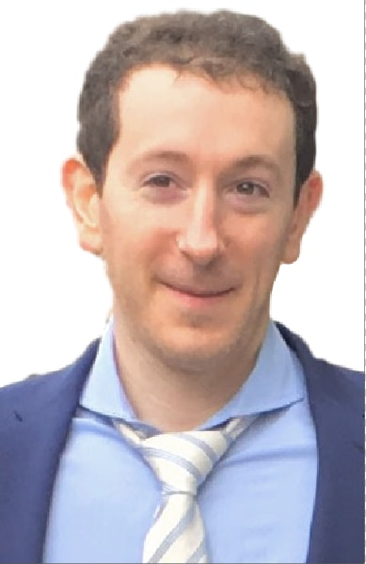
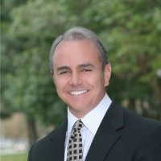
OPPORTUNITY | SOLUTION | BUSINESS
Team
Austin Cohen
Extensive consumer venture capital and operating company experience
Columbia Business School (MBA); Columbia University (BA); Roslyn High School Valedictorian
Michael Rojas
Co-Founder and CEO of Iron Grip Barbell Company
Iron Grip is the largest provider of commercial free weight equipment worldwide

Slide 19
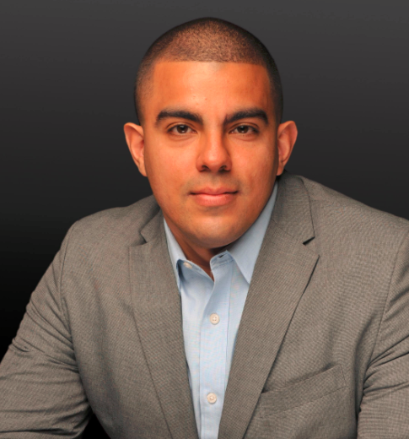
OPPORTUNITY | SOLUTION | BUSINESS
The Team
Austin Cohen
CEO
Kevin Batista
COO
Michael Rojas
Head of
Business Development
Consumer venture capitalist with extensive operating experience. Austin co-founded a competitive platform and has launched multiple fitness brands. He is a Partner and first employee at private aviation startup Wheels Up ($800M valuation). Austin received his MBA and BS from Columbia University.
Seasoned management consultant with strategy and operational consulting experience across entertainment, media and consumer retail sectors. He has worked for premier consulting firms including McKinsey & Co. and PwC Advisory. Kevin received his MBA from Columbia Business School and BS in Finance from NYU Stern.
Co-Founder, co-CEO & President of Iron Grip Barbell Company
Iron Grip is the largest provider of commercial free weight equipment worldwide. Michael received his MBA from USC School of Business, Pepperdine University
Notes:
Kevin is
Seasoned management consultant with strategy and operational consulting experience across entertainment, media and consumer retail sectors. He has worked for premier consulting firms including McKinsey & Co. and PwC Advisory. Kevin received his MBA from Columbia Business School and BS in Finance from NYU Stern.

Slide 20
WORKOUT WHEREVER, WHENEVER.
Austin Cohen
516.417.2741
austin@flexit.fit
FlexIt,Inc. Is an a-la-carte non-membership solution to access health and fitness clubs wherever, whenever. FlexIt provides on-demand access to gyms so that users can enjoy the privileges of membership without the hassle, and pay solely for the time they use.
This presentation contains forward-looking statements. In some cases, you can identify forward-looking statements by terms such as “may,” “will,” “should,” “could,” “would,” “expects,” “plans,” “anticipates,” “believes,” “estimates,” “projects,” “predicts,” “potential,” and similar expressions. Forward-looking statements involve assumptions, variables, risks, and uncertainties that may cause actual results, performance, or financial conditions to be materially different from the expectations of future results, performance or financial conditions expressed or implied in such forward-looking statements. Such factors include, but are not limited to our ability to raise capital, develop certain technologies and generate sales, and ability to expand and grow our distribution channels, changes in business plans, regulatory changes and political and economic factors. Actual outcomes and results may differ materially from what is expressed or forecasted in such forward-looking statements due to numerous risks and uncertainties. Certain information provided in this presentation comes from publicly available or third-party sources. While FlexIt, Inc. believes such information to be correct, it makes no expressed or implied representation or warranty as to the accuracy or completeness of any such information or any forward-looking statements set forth in this presentation or as to the reasonableness, accuracy, or completeness of the assumptions from which the forward-looking statements are derived. Forward-looking and all other statements made in this presentation speak only as of the date on which they are made. FlexIt, Inc. has no obligation to update or revise any information or any forward-looking statement to reflect any actual results or changes in its expectations or any change in events, conditions or circumstances on which any such statement is based. This presentation does not constitute or form an offer to sell or issue or solicitation of an offer to purchase or subscribe for any securities of FlexIt, Inc. in any jurisdiction, and no part of this presentation shall form the basis of or be relied upon in connection with any such offer or solicitation or any contract or commitment. Specifically this presentation does not constitute a “prospectus” within the meaning of the U.S. Securities Act of 1933, as amended. The contents of this presentation may not be reproduced, redistributed or passed on, directly or indirectly, to any other person or published, in whole or in part, for any purpose. © FlexIt, Inc.

